Slide 1

Hacking Environment Web Application in Shoping website.
Detailed Developer Report

Slide 2
Categorisation of Vulnerabilities
Critical Vulnerabilities
Moderate Vulnerabilities
Low level Vulnerabilities

Slide 3
Vulnerability Statistics
Critical 3 | Moderate 3 | Low 2

Slide 4
Security Status – Extremely Vulnerable
. Hacker can steal all records in databases.
. Hacker can extract mobile number of all customers using id .
. Hacker can extract username , user ID or any personal information.

Slide 5
No | Severity | Vulnerability | Count
1. | Critical | SQL Injection | 1
2. | Critical | PII Leakage | 1
3. | Critical | Insecure Direct Object Reference | 1
4. | Moderate | Cross-Site Request Forgery | 1
5. | Moderate | Default files and pages | 1
6. | Moderate | Forced Browsing flaws | 1
7. | Low | Components with known vulnerabilities | 1
8. | Low | PHP | 1

Slide 6
1. SQL Injection
SQL Injection
(Critical)
Below mention URL in the Lifestyle Store Products module is vulnerable to SQL injection attack.
Affected URL :
. http://3.110.127.25/products.php?cat=1
Affected Parameters :
. cat (GET parameter)
Payload:
. Cat=1’

Slide 7
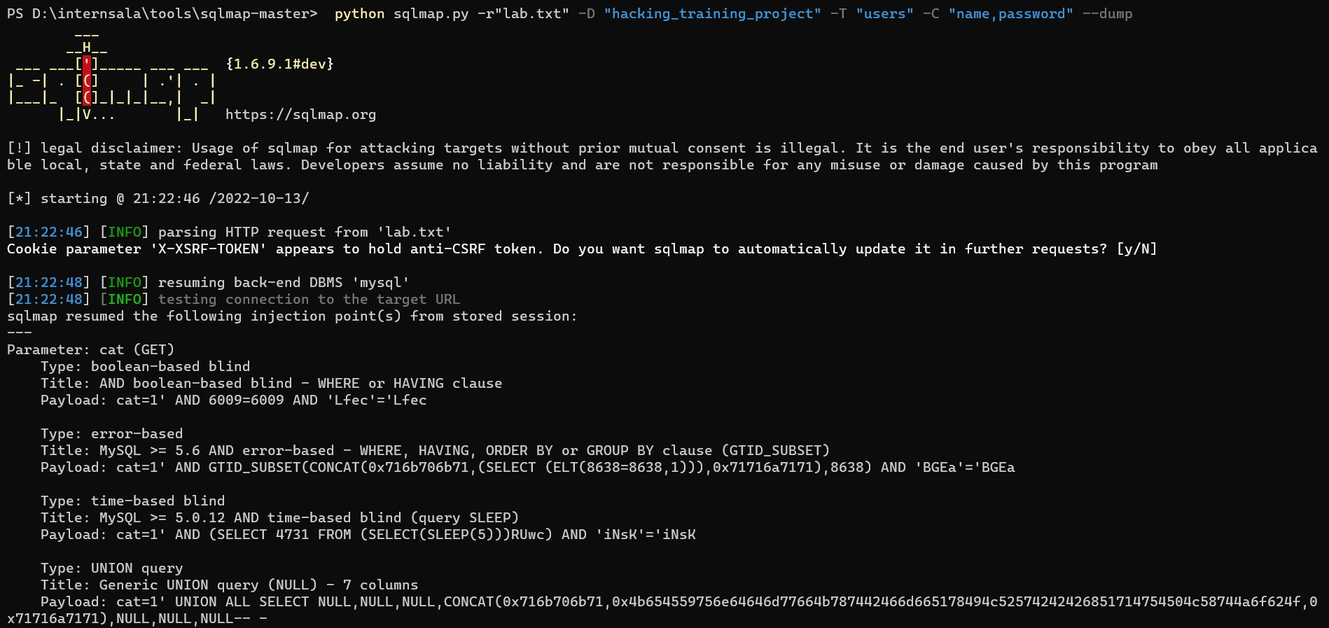
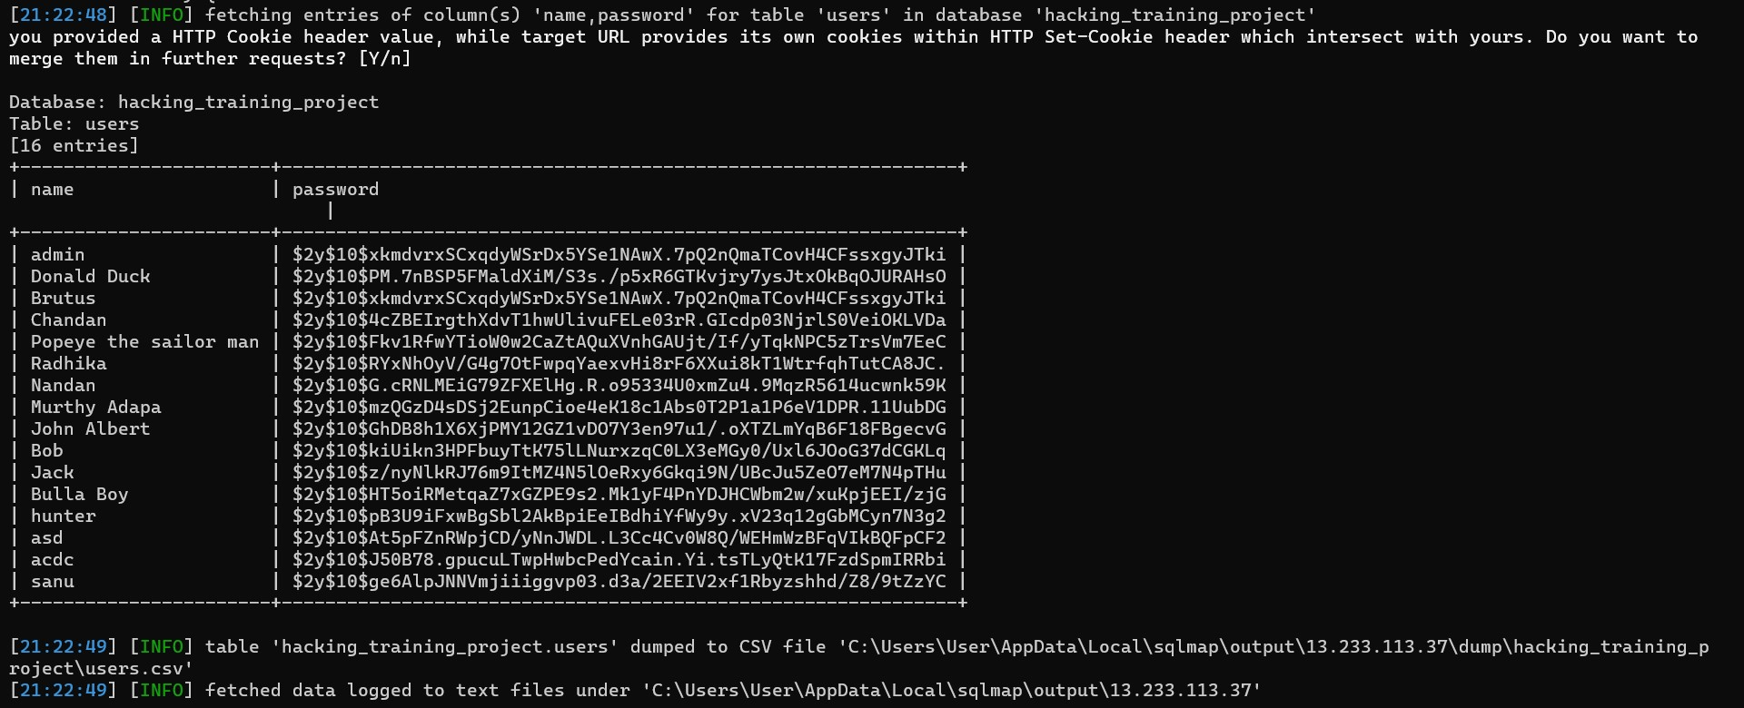
Observation .Navigate to products page where you will see list of products. Click any like cat . you will see the products . Notice the GET parameter CAT in URL.
http://3.110.127.25/products.php?cat=1

Slide 8
Proof of Concept (PoC) .Attacker can execute SQL command as show in fig below . Here we have used the payload to extract the username and passwords.

Slide 9
Business Impact – Extremely High
Using this vulnerability, attacker can execute arbitrary sql commands on Internshala server and gain complete access to internal database along with all customer data inside it.

Slide 10
Recommendation
Take the following precautions to avoid exploitation of SQL injections:
. Use regular expressions as whitelists for structured data (such as name, age, income, survey response, zip code) to ensure strong input validation.
. Parameterized queries are a means of pre-compiling an SQL statement so that you can then supply the parameters in order for the statement to be executed. This method makes it possible for the database to recognize the code and distinguish it from input data.
. Always use character-escaping functions for user-supplied input provided by each database management system (DBMS). This is done to make sure the DBMS never confuses it with the SQL statement provided by the developer.
. Don't connect your application to the database using an account with root access. This should be done only if absolutely needed since the attackers could gain access to the whole system.

Slide 11
References
https://owasp.org/www-community/attacks/SQL_Injection
https://www.geeksforgeeks.org/sql-injection-2

Slide 12
2. PII Leakage
PII Leakage
(critical)
Below mention URL in the Lifestyle Store is vulnerable to PII Leakage.
Affected URL :
. http://3.110.127.25/static/images/
. Affected Parameters :
. static
Payload:
. Static/images/

Slide 13
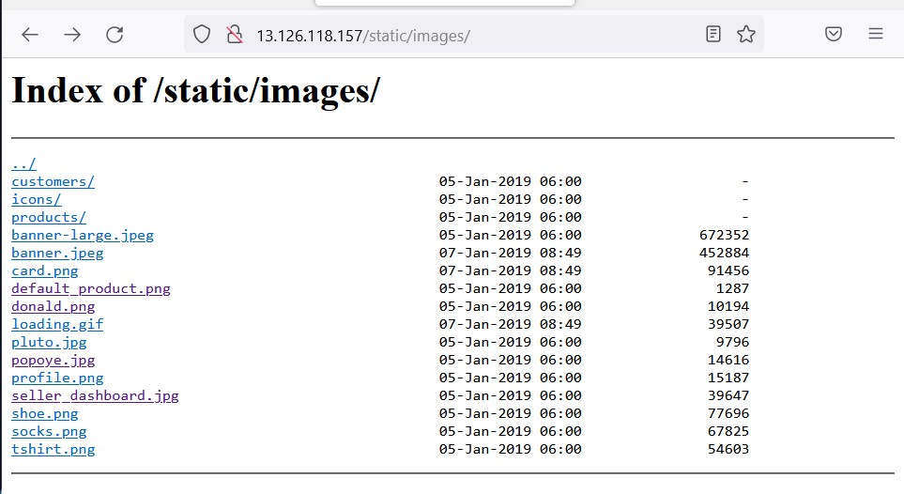
Poc :- . Attacker can execute command as show in fig below . Here we have used the payload to extract the data .

Slide 14
Recommendation
Data governance mitigates most regulatory compliance and data compliance risks, at least in theory. It establishes rules for managing PII. For example, data governance policy might require that PII be classified as such and carefully tracked in its storage and usage. This is a good idea, except is has a big flaw. The frenetic nature of storage and backup render intentional data classification a partial solution at best. A lot of PII can be stored in the enterprise without anyone knowing where it is or realizing it ever needed to be classified.

Slide 15
References
https://www.csoonline.com/article/3645648

Slide 16
3. Insecure Direct Object Reference
Insecure Direct Object Reference (critical)
Below mention URL in the Lifestyle Store is vulnerable to IDOR.
Affected URL :
. http://3.110.127.25/orders/orders.php?customer=13
. Affected Parameters :
. GET
Payload:
. /orders/orders.php?customer=13

Slide 17
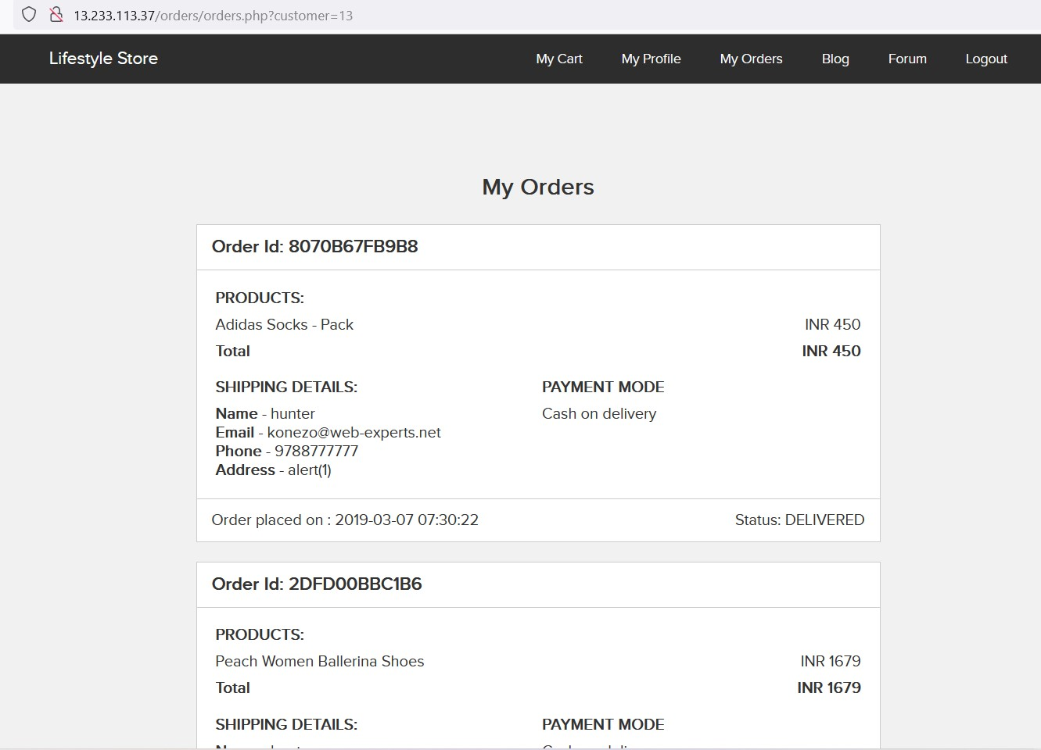
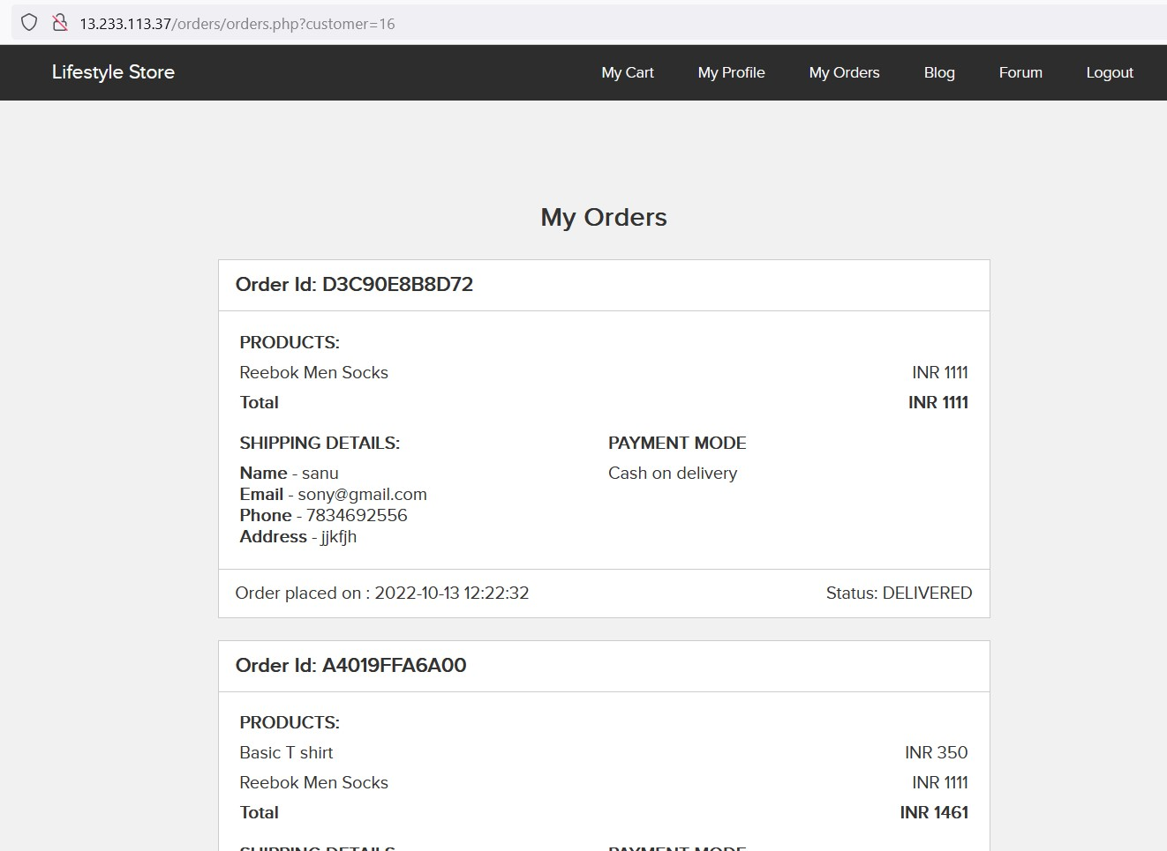
PoC :- . Attacker can execute command as show in fig below . Here we have used the payload to extract the data .

Slide 18
Recommendations
An insecure direct object reference (IDOR) occurs when a web application provides users with an authorized reference or ID that can be used to access or change other unauthorized information. This is a consequence of the application only requiring a reference to access certain information instead of authenticating the user’s credentials.

Slide 19
References
. https://portswigger.net/web-security/access-control/idor

Slide 20
4. Cross-Site Request Forgery
Cross-Site Request Forgery
(Moderate)
Below mention URL in the Lifestyle Store is vulnerable to CSRF .
Affected URL :
. http://3.110.127.25/profile/16/edit/
. Affected Parameters :
. Post Request in Burpsuite
Payload:
. profile/16/edit/

Slide 21
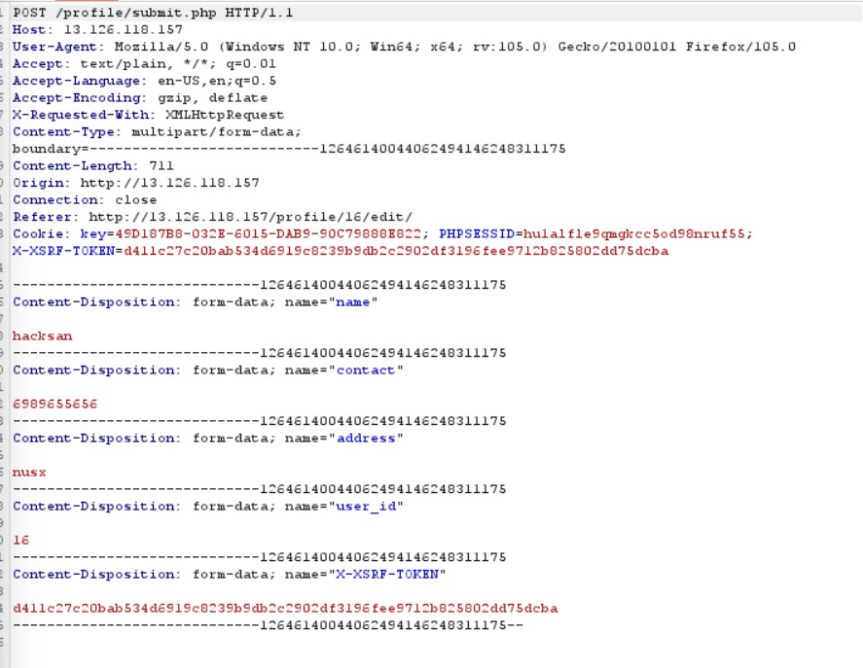
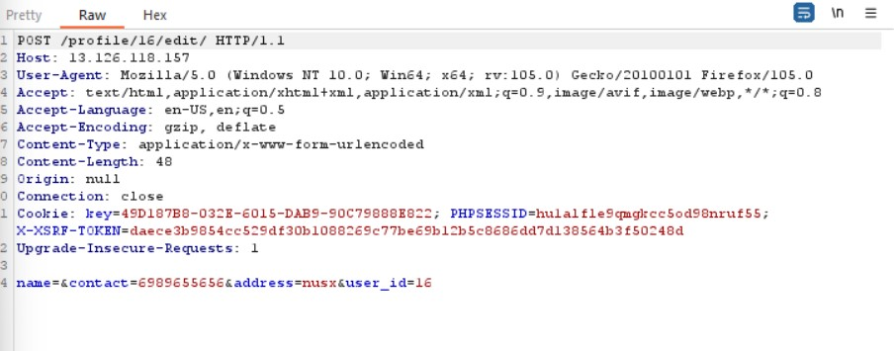
PoC :-
. Attacker can pass post request using HTML code .

Slide 22
Recommendation
A website should not permit state-changing operations based on GET requests.
Always limit session duration for connected users. Websites should terminate sessions whenever users leave the website.
Cross-Site Scripting (XSS) prevention controls should also be implemented, since XSS can be used to exploit CSRF.

Slide 23
References
https://portswigger.net/web-security/csrf

Slide 24
5. Default files and pages
Default files and pages
(Moderate)
Below mention URL in the Lifestyle Store is vulnerable to Default files and pages .
Affected URL :
. http://13.126.118.157/phpinfo.php
. Affected Parameters :
. php info
Payload:
. phpinfo.php

Slide 25
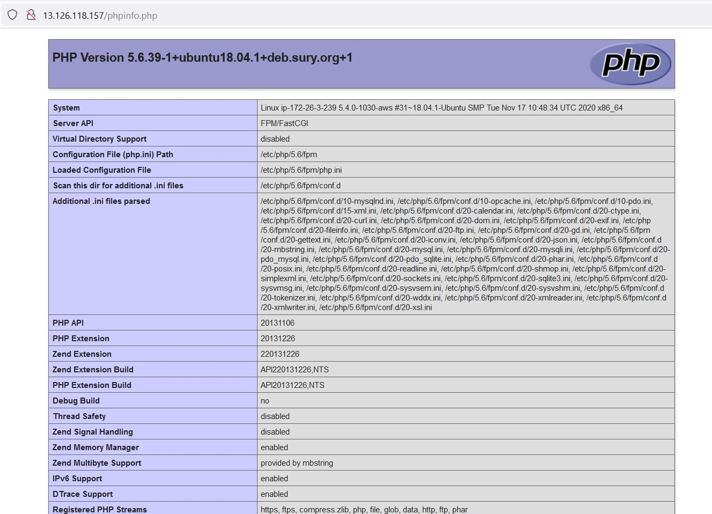
PoC:-
. Attacker can use php code in URL and get information about website.

Slide 26
Recommendation
. you need to find out specific server configuration information in order to install and run a specific web application or script, or just to troubleshoot your server. If your server has php installed, you can get a great deal of this info by making and running a phpinfo file from your server. You can easily create a phpinfo file to access this information.

Slide 27
References
https://www.php.net/manual/en/function.xdiff-file-patch.php

Slide 28
6. Forced Browsing flaws
. Forced Browsing flaws
(Moderate)
Below mention URL in the Lifestyle Store is vulnerable to
Forced Browsing Flaws .
Affected URL :
. http://13.126.118.157/profile/profile.php
. Affected Parameters :
. GET
Payload:
. profile.php

Slide 29
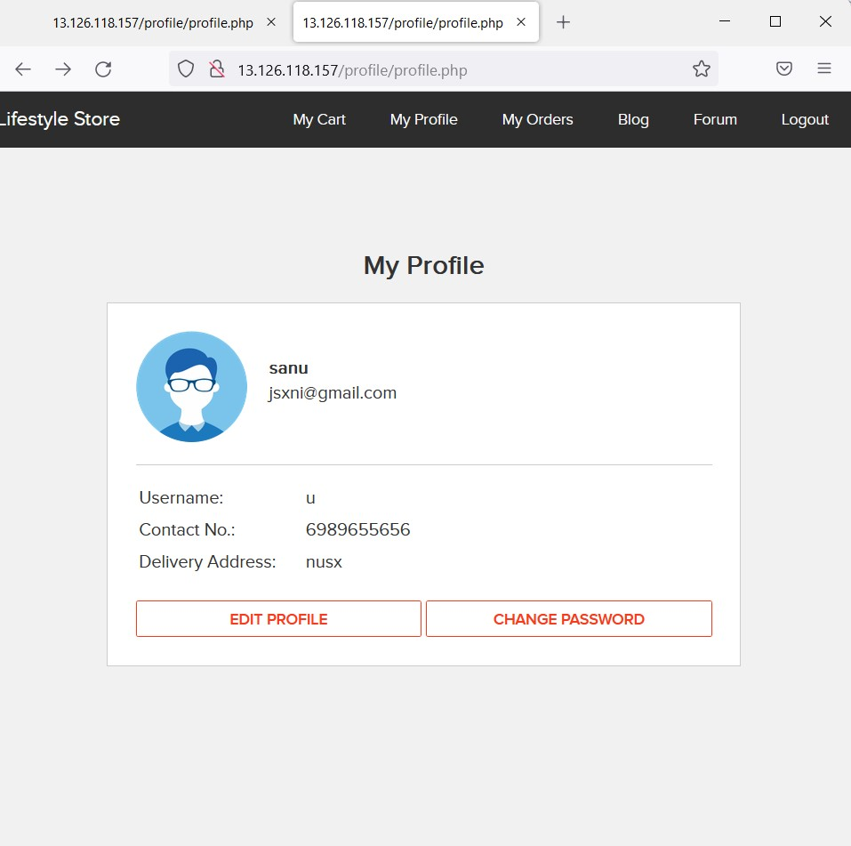
Poc:-
Attacker can use php code in URL and get information about customer details .

Slide 30
Recommendation
Constrained perusing can be forestalled utilizing two strategies: satisfactory access control and forcing an application URL space allowlist.
Giving clients access similar with their honors and no more fitting access control and approval arrangements suggest. A web application firewall (WAF) is the best API security because it gives access control requirement and assurance against meeting based assaults at the URL level by applying approval arrangements.
Permitting express admittance to safe, permitted URLs is important for making an allowlist. Any solicitation outside of this URL district will be dismissed naturally, as these URLs are viewed as a fundamental component of the functioning application.

Slide 31
References
https://www.wallarm.com/what/forced-browsing-attack
https://www.acunetix.com/blog/web-security-zone/what-is-forced-browsing/

Slide 32
7. Components with known vulnerabilities
Components with known vulnerabilities
(Low)
Below mention URL in the Lifestyle Store is vulnerable to components with known vulnerabilities .
Affected URL :
. http://13.126.117.66
. Affected Parameters :
. GET
Payload:
. In Burpshuit

Slide 33
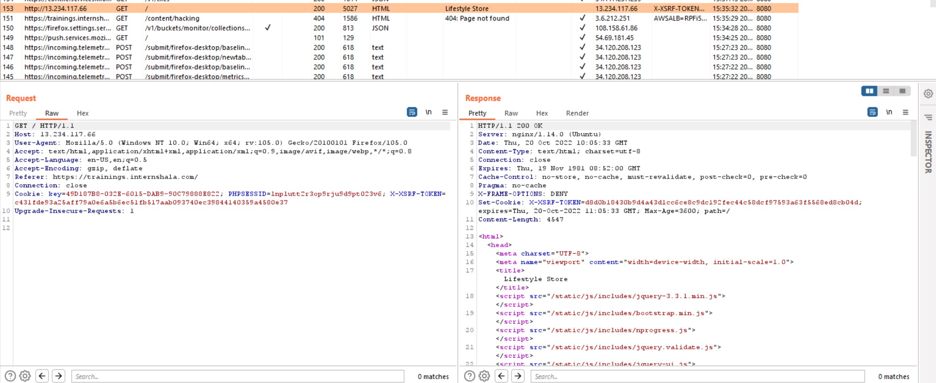
PoC:-
Attacker can use the URL in Burpsuit and get information about website.

Slide 34
Recommendation
Components with known vulnerabilities : These components can be defined as the third-party apps or software or platforms that are outdated and contain bugs that are public to all, that is- sites like https://www.exploit-db.com contain the full detail as to how to exploit the bugs to put the security of the whole website under severe threat.

Slide 35
References
https://www.geeksforgeeks.org/what-is-components-with-known-vulnerability/
https://crashtest-security.com/using-components-with-known-vulnerabilities

Slide 36
8. Php
PHP
(LOW)
Below mention URL in the Lifestyle Store is vulnerable to PHP.
Affected URL :
. http://13.233.113.37/profile/14/edit/
. Affected Parameters :
. GET
Payload:
. Php

Slide 37
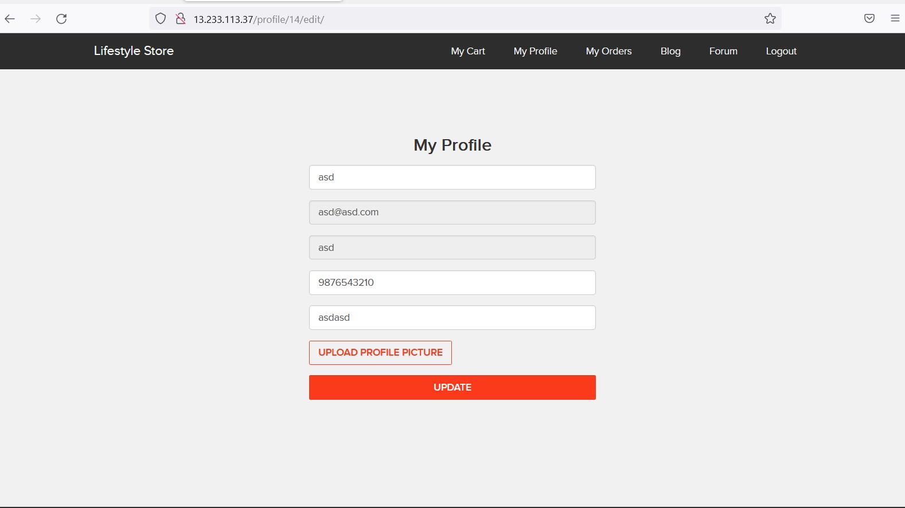
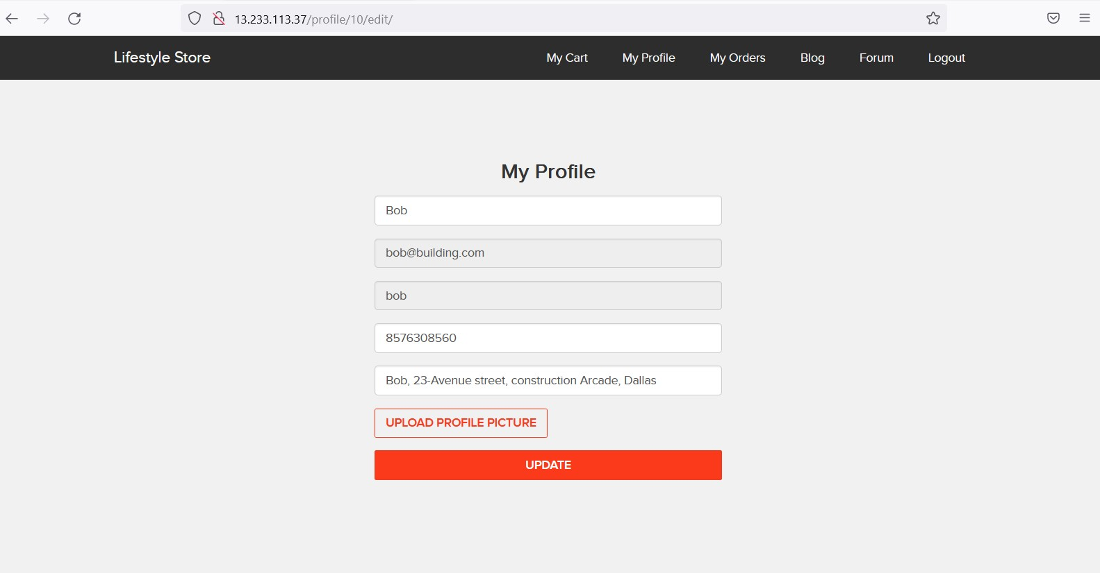
PoC:-
Attacker can use the php in URL and get access another profile .

Slide 38
Recommendation
A flaw in the popular PHP server-side scripting language could be exploited remotely to cause a "memory limit request termination" on the affected machine. An attacker could exploit this to take control of the machine and run any code they wanted.

Slide 39
References
https://www.networkworld.com/article/2323705/php-patches-available.html
https://www.infoworld.com/article/3020451

Slide 40
THANK YOU

